Slide 1
Attention-based Model
Hung-yi Lee

Slide 2
Attention-based Model
Information from the sensors (e.g. eyes, ears)
When the input is a very long sequence or an image
Sensory Memory
Pay attention on partial of the input object each time
Attention
Working Memory
Encode
Retrieval
Long-term Memory
Notes:
Sensory Memory 感官记忆
Working Memory 工作记忆
Long-term Memory 长期记忆
Information from the sensors (e.g. eyes, ears) 来自传感器的信息（如眼睛、耳朵）
Retrieval检索
When the input is a very long sequence or an image 当输入是一个很长的序列或图像时
Pay attention on partial of the input object each time 每次都要注意输入对象的部分
In RNN/LSTM, larger memory implies more parameters 在RNN/LSTM中，更大的内存意味着更多的参数
Increasing memory size will not increasing parameters 增加内存大小不会增加参数

Slide 3
Attention-based Model
Information from the sensors (e.g. eyes, ears)
When the input is a very long sequence or an image
Sensory Memory
Pay attention on partial of the input object each time
Attention
Working Memory
In RNN/LSTM, larger memory implies more parameters
Encode
Retrieval
Increasing memory size will not increasing parameters
Long-term Memory
Notes:
Sensory Memory 感官记忆
Working Memory 工作记忆
Long-term Memory 长期记忆
Information from the sensors (e.g. eyes, ears) 来自传感器的信息（如眼睛、耳朵）
Retrieval检索
When the input is a very long sequence or an image 当输入是一个很长的序列或图像时
Pay attention on partial of the input object each time 每次都要注意输入对象的部分
In RNN/LSTM, larger memory implies more parameters 在RNN/LSTM中，更大的内存意味着更多的参数
Increasing memory size will not increasing parameters 增加内存大小不会增加参数

Slide 4
Attention on Sensory Information
Information from the sensors (e.g. eyes, ears)
Sensory Memory
Attention
Working Memory
Encode
Retrieval
Long-term Memory
Notes:
Sensory Memory 感官记忆
Working Memory 工作记忆
Long-term Memory 长期记忆
Information from the sensors (e.g. eyes, ears) 来自传感器的信息（如眼睛、耳朵）
Retrieval检索
When the input is a very long sequence or an image 当输入是一个很长的序列或图像时
Pay attention on partial of the input object each time 每次都要注意输入对象的部分
In RNN/LSTM, larger memory implies more parameters 在RNN/LSTM中，更大的内存意味着更多的参数
Increasing memory size will not increasing parameters 增加内存大小不会增加参数

Slide 5
Machine Translation
Sequence to sequence learning: Both input and output are both sequences with different lengths.
E.g. 機器學習→machine learning
Information of the whole sentences
machine
learning
===
機
器
學
習
Notes:
Not state-of-the-art
Sequence to sequence learning 的问题有两个：
1、解码时如果只在第一次有编码的输出，后面会不会已经忘记编码输出
解决这个问题的办法是在解码时每次都输入编码的输出
2、编码的输出一定可以代表这个输入语句吗，特别是在输入语句特别长的时候

Slide 6
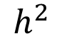
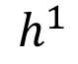
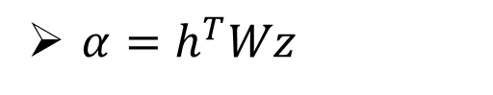
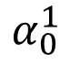
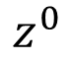
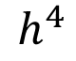
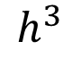
Machine Translation
Attention-based model
match
What is ?
$$α_{0}^{1}$$
Cosine similarity of z and h
match
$$z^{0}$$
Small NN whose input is z and h, output a scalar
$$h^{1}$$
$$h^{2}$$
$$h^{3}$$
$$h^{4}$$
$α=h^{T}Wz$
How to learn the parameters?
機
器
學
習

Slide 7
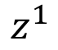
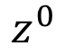
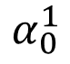
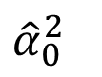
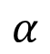
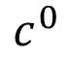
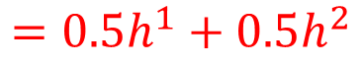
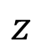
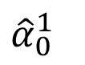
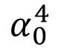
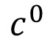
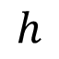
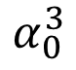
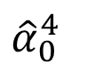
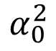
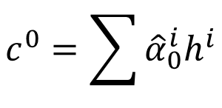
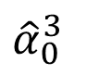
Machine Translation
How to learn the parameters?
Attention-based model
$$α$$
machine
$$c^{0}$$
match
0.5
$${\hat{α}}_{0}^{1}$$
0.5
$${\hat{α}}_{0}^{2}$$
0.0
$${\hat{α}}_{0}^{3}$$
0.0
$${\hat{α}}_{0}^{4}$$
$$z$$
$$z^{0}$$
$$z^{1}$$
$$h$$
softmax
$$α_{0}^{1}$$
$$α_{0}^{2}$$
$$α_{0}^{3}$$
$$α_{0}^{4}$$
$$c^{0}$$
As RNN input
$$h^{1}$$
$$h^{2}$$
$$h^{3}$$
$$h^{4}$$
$$c^{0}=\sum{{\hat{α}}_{0}^{i}h^{i}}$$
機
器
學
習
$$=0.5h^{1}+0.5h^{2}$$
Notes:
z^0 是 init memory
也就是 z 是 memory
如何生成或者更新 Z^1 和 生成 machine 这个词的
Z^0 和 C^0 做某些计算得到 Z^1
Z^1 通过和某个矩阵相乘得到 machine 这个词

Slide 8
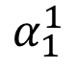
Machine Translation
Attention-based model
machine
$$α_{1}^{1}$$
match
$$z^{0}$$
$$z^{1}$$
$$c^{0}$$
$$h^{1}$$
$$h^{2}$$
$$h^{3}$$
$$h^{4}$$
機
器
學
習

Slide 9
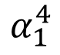
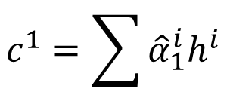
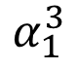
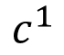
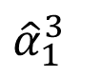
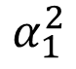
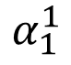
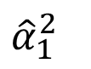
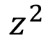
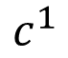
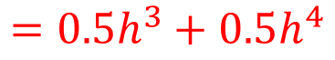
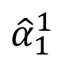
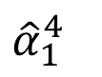
Machine Translation
Attention-based model
machine
learning
$$c^{1}$$
0.0
$${\hat{α}}_{1}^{1}$$
0.0
$${\hat{α}}_{1}^{2}$$
0.5
$${\hat{α}}_{1}^{3}$$
0.5
$${\hat{α}}_{1}^{4}$$
$$z^{0}$$
$$z^{1}$$
$$z^{2}$$
softmax
$$α_{1}^{1}$$
$$α_{1}^{2}$$
$$α_{1}^{3}$$
$$α_{1}^{4}$$
$$c^{0}$$
$$c^{1}$$
$$h^{1}$$
$$h^{2}$$
$$h^{3}$$
$$h^{4}$$
$$c^{1}=\sum{{\hat{α}}_{1}^{i}h^{i}}$$
機
器
學
習
$$=0.5h^{3}+0.5h^{4}$$

Slide 10
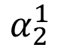
Machine Translation
Attention-based model
machine
learning
……
$$α_{2}^{1}$$
……
match
$$z^{0}$$
$$z^{1}$$
$$z^{2}$$
$$c^{0}$$
$$c^{1}$$
……
$$h^{1}$$
$$h^{2}$$
$$h^{3}$$
$$h^{4}$$
The same process repeat until generating
機
器
學
習
======

Slide 11
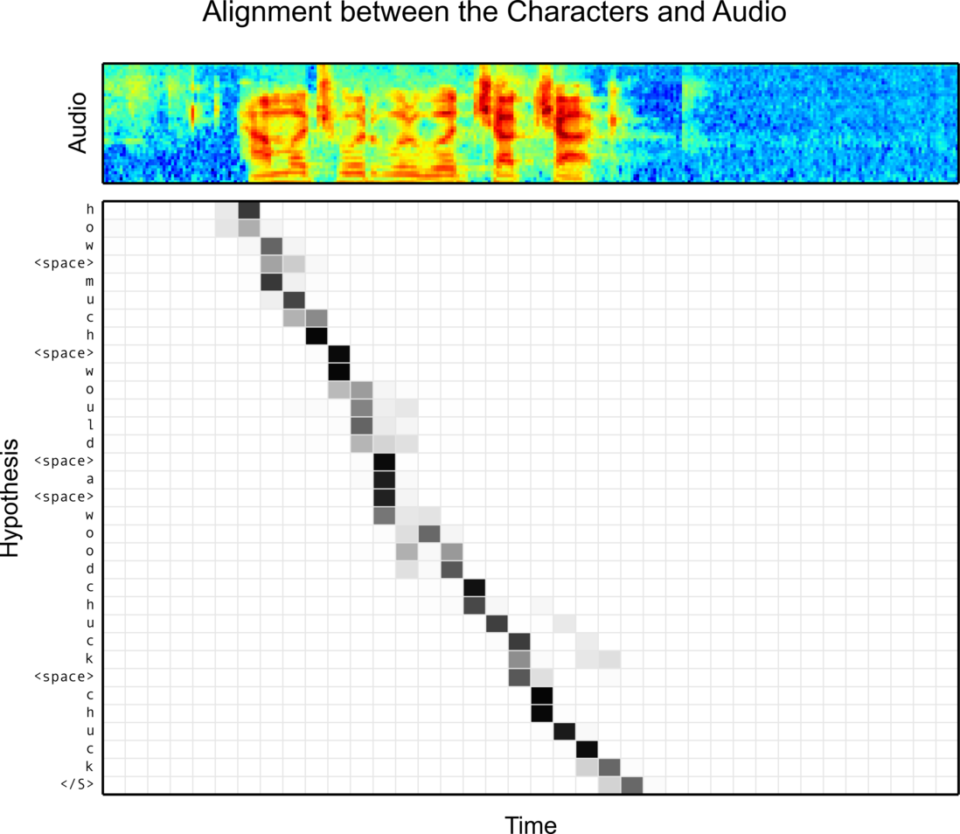
Speech Recognition
William Chan, Navdeep Jaitly, Quoc V. Le, Oriol Vinyals, “Listen, Attend and Spell”, arXiv’15

Slide 12

Image Caption Generation
Input an image, but output a sequence of words
A vector for whole image
(斷)
a
woman
is
===
CNN
……
Input image
Notes:
Image Caption Generation 图像说明生成
A woman is throwing a Frisbee in a part.

Slide 13
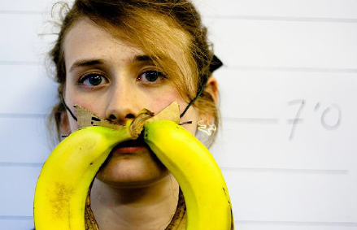
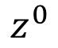
Image Caption Generation
A vector for each region
match
$$z^{0}$$
0.7
CNN
filter
filter
filter
filter
filter
filter
filter
filter
filter
filter
filter
filter

Slide 14
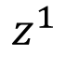
Image Caption Generation
Word 1
A vector for each region
$$z^{0}$$
$$z^{1}$$
CNN
filter
filter
filter
weighted sum
filter
filter
filter
0.7
0.1
0.1
0.1
0.0
0.0
filter
filter
filter
filter
filter
filter

Slide 15
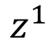
Image Caption Generation
Word 1
Word 2
A vector for each region
$$z^{0}$$
$$z^{1}$$
$$z^{1}$$
weighted sum
CNN
filter
filter
filter
filter
filter
filter
0.0
0.8
0.2
0.0
0.0
0.0
filter
filter
filter
filter
filter
filter

Slide 16
Image Caption Generation
Good captions
Notes:
https://github.com/ryankiros/neural-storyteller

Slide 17
Image Caption Generation
Bad captions

Slide 18
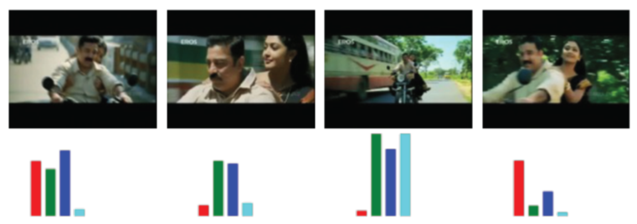
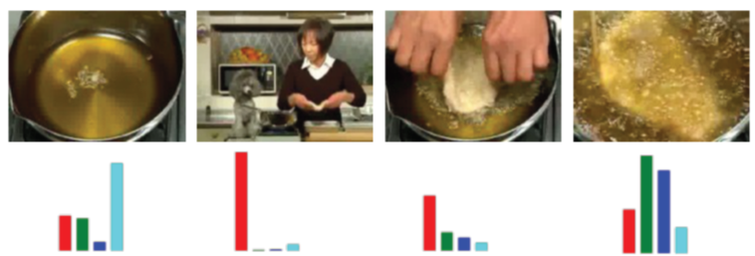

Notes:
Another application is summarization

Slide 19
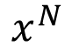
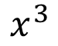
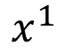
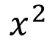





Reading Comprehension
Answer
$$=\sum_{n=1}^{N}{α_{n}x^{n}}$$
DNN
Sentence to vector can be jointly trained.
Extracted Information
$$α_{1}$$
$$α_{2}$$
$$α_{3}$$
$$α_{N}$$
Document
……
$$x^{N}$$
$$x^{1}$$
$$x^{2}$$
$$x^{3}$$
Match
q
Query
vector
Please refer to the lecture on 2015/12/04
Notes:
Reading Comprehension 阅读理解

Slide 20









Memory
Network
Answer
$$=\sum_{n=1}^{N}{α_{n}h^{n}}$$
Extracted Information
DNN
Jointly learned
$$h^{1}$$
$$h^{2}$$
$$h^{3}$$
……
$$h^{N}$$
Hopping
$$α_{1}$$
$$α_{2}$$
$$α_{3}$$
$$α_{N}$$
Document
……
$$x^{N}$$
$$x^{1}$$
$$x^{2}$$
$$x^{3}$$
Match
q
Query
vector
Please refer to the lecture on 2015/12/04

Slide 21



Memory
Network
DNN
a
Extract information
……
……
Compute attention
Extract information
……
……
Compute attention
q

Slide 22

Memory Network
Performance of Hopping
Demo video: https://www.facebook.com/Engineering/videos/10153098860532200/

Slide 23


Special Attention: Spatial Transformers
Max Jaderberg, Karen Simonyan, Andrew Zisserman, Koray Kavukcuoglu, Spatial Transformer Networks, arXiv’15
CNN
Bad results
CNN
Good results
Jointly learned

Slide 24
Attention on Memory
Information from the sensors (e.g. eyes, ears)
Sensory Memory
Attention
Working Memory
Encode
Retrieval
Long-term Memory
Notes:
Sensory Memory 感官记忆
Working Memory 工作记忆
Long-term Memory 长期记忆
Information from the sensors (e.g. eyes, ears) 来自传感器的信息（如眼睛、耳朵）
Retrieval检索
When the input is a very long sequence or an image 当输入是一个很长的序列或图像时
Pay attention on partial of the input object each time 每次都要注意输入对象的部分
In RNN/LSTM, larger memory implies more parameters 在RNN/LSTM中，更大的内存意味着更多的参数
Increasing memory size will not increasing parameters 增加内存大小不会增加参数

Slide 25

Neural Turing Machine
von Neumann architecture
Actually, Neural Turing Machine is an advanced RNN/LSTM.
https://www.quora.com/How-does-the-Von-Neumann-architecture-provide-flexibility-for-program-development
Notes:
范紐曼型架構（英語：von Neumann architecture）
算術邏輯單元

Slide 26









Neural Turing Machine
y¹
y²
h⁰
h¹
h²
$$r^{0}=\sum{{\hat{α}}_{0}^{i}m_{0}^{i}}$$
r⁰
x¹
x²
Retrieval process
$${\hat{α}}_{0}^{1}$$
$${\hat{α}}_{0}^{2}$$
$${\hat{α}}_{0}^{3}$$
$${\hat{α}}_{0}^{4}$$
Long term memory
$$m_{0}^{1}$$
$$m_{0}^{2}$$
$$m_{0}^{3}$$
$$m_{0}^{4}$$
Notes:
What is the different

Slide 27












Neural Turing Machine
y¹
y²
h⁰
h¹
h²
$$r^{0}=\sum{{\hat{α}}_{0}^{i}m_{0}^{i}}$$
r⁰
x¹
x²
$$k_{}^{1}$$
$$e_{}^{1}$$
$$a_{}^{1}$$
$${\hat{α}}_{0}^{1}$$
$${\hat{α}}_{0}^{2}$$
$${\hat{α}}_{0}^{3}$$
$${\hat{α}}_{0}^{4}$$
$${\hat{α}}_{1}^{1}$$
$${\hat{α}}_{1}^{2}$$
$${\hat{α}}_{1}^{3}$$
$${\hat{α}}_{1}^{4}$$
softmax
$$m_{0}^{1}$$
$$m_{0}^{2}$$
$$m_{0}^{3}$$
$$m_{0}^{4}$$
$$α_{1}^{1}$$
$$α_{1}^{2}$$
$$α_{1}^{3}$$
$$α_{1}^{4}$$
(simplified)
$$α_{1}^{i}=\left(1−λ\right)α_{0}^{i}+cos\left(m_{0}^{i},k^{1}\right)$$
Notes:
What is the different

Slide 28













Neural Turing Machine
Encode process
$$m_{1}^{i}$$
$$=$$
$$m_{0}^{i}$$
$$∗$$
$$1$$
$${−\hat{α}}_{1}^{i}$$
$$e_{}^{1}$$
$${+\hat{α}}_{1}^{i}$$
$$a_{}^{1}$$
(element-wise)
$$k_{}^{1}$$
$$e_{}^{1}$$
$$a_{}^{1}$$
$${\hat{α}}_{0}^{1}$$
$${\hat{α}}_{0}^{2}$$
$${\hat{α}}_{0}^{3}$$
$${\hat{α}}_{0}^{4}$$
$${\hat{α}}_{1}^{1}$$
$${\hat{α}}_{1}^{2}$$
$${\hat{α}}_{1}^{3}$$
$${\hat{α}}_{1}^{4}$$
$$m_{0}^{1}$$
$$m_{0}^{2}$$
$$m_{0}^{3}$$
$$m_{0}^{4}$$
$$m_{1}^{1}$$
$$m_{1}^{2}$$
$$m_{1}^{3}$$
$$m_{1}^{4}$$
Notes:
What is the different

Slide 29








Neural Turing Machine
Wei Zhang, Yang Yu, Bowen Zhou, Structured Memory for Neural Turing Machines, arXiv’15
y¹
y²
h⁰
h¹
h²
r⁰
x¹
r¹
x²
$${\hat{α}}_{0}^{1}$$
$${\hat{α}}_{0}^{2}$$
$${\hat{α}}_{0}^{3}$$
$${\hat{α}}_{0}^{4}$$
$${\hat{α}}_{1}^{1}$$
$${\hat{α}}_{1}^{2}$$
$${\hat{α}}_{1}^{3}$$
$${\hat{α}}_{1}^{4}$$
$${\hat{α}}_{2}^{1}$$
$${\hat{α}}_{2}^{2}$$
$${\hat{α}}_{2}^{3}$$
$${\hat{α}}_{2}^{4}$$
$$m_{0}^{1}$$
$$m_{0}^{2}$$
$$m_{0}^{3}$$
$$m_{0}^{4}$$
$$m_{1}^{1}$$
$$m_{1}^{2}$$
$$m_{1}^{3}$$
$$m_{1}^{4}$$
$$m_{2}^{1}$$
$$m_{2}^{2}$$
$$m_{2}^{3}$$
$$m_{2}^{4}$$
Notes:
What is the different!!!!!!!!!!!!!!!!!!???????????????????????

Slide 30
Stack RNN
Armand Joulin, Tomas Mikolov, Inferring Algorithmic Patterns with Stack-Augmented Recurrent Nets, 2015
stack
y^{t}
0.7
0.2
0.1
Push, Pop, Nothing
Information to store
h^{t}
Push
X0.7
+
Pop
-1
-1
X0.2
+
x^{t}
Nothing
-1
X0.1
Notes:
Armand Joulin, Tomas Mikolov, Inferring Algorithmic Patterns with Stack-Augmented Recurrent Nets, 2015

Slide 31
Concluding Remarks
Information from the sensors (e.g. eyes, ears)
Sensory Memory
Translation
Speech Recognition
Caption Generation
Question Answering
Attention
Working Memory
Encode
Retrieval
Neural Turing Machine, Stack RNN
Long-term Memory
Notes:
Tomas version

Slide 32
Reference
End-To-End Memory Networks. S. Sukhbaatar, A. Szlam, J. Weston, R. Fergus. arXiv Pre-Print, 2015.
Neural Turing Machines. Alex Graves, Greg Wayne, Ivo Danihelka. arXiv Pre-Print, 2014
Ask Me Anything: Dynamic Memory Networks for Natural Language Processing. Kumar et al. arXiv Pre-Print, 2015
Neural Machine Translation by Jointly Learning to Align and Translate. D. Bahdanau, K. Cho, Y. Bengio; International Conference on Representation Learning 2015.
Show, Attend and Tell: Neural Image Caption Generation with Visual Attention. Kelvin Xu et. al.. arXiv Pre-Print, 2015.
Attention-Based Models for Speech Recognition. Jan Chorowski, Dzmitry Bahdanau, Dmitriy Serdyuk, Kyunghyun Cho, Yoshua Bengio. arXiv Pre-Print, 2015.
A Neural Attention Model for Abstractive Sentence Summarization. A. M. Rush, S. Chopra and J. Weston. EMNLP 2015.

Slide 33

Teaching Machines to Read and Comprehend, Hermann et. al. (2015)

